Slide 1

INTRODUCTION TO STATISTICAL DATA ANALYSIS USING R & RSTUDIO
LUMUMBA WANDERA VICTOR
24TH FEB, 2025
.

Slide 2
Session 8: Time Series Analysis
Introduction to Time Series Analysis
What is a Time Series?
A time series is a sequence of data points recorded at successive time intervals. It captures how a variable evolves over time. Examples include:
Stock prices (daily closing prices)
Temperature readings (hourly/daily)
Economic indicators (GDP, inflation)
Health data (COVID-19 cases per week)

Slide 3
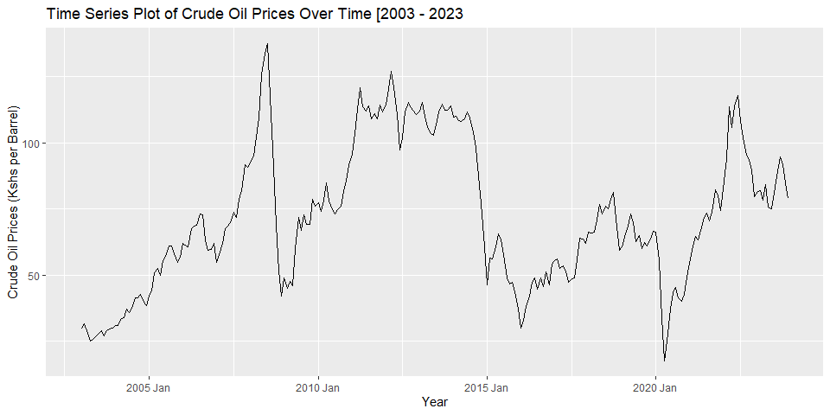
Session 8: Time Series Analysis

Slide 4
Session 8: Time Series Analysis
Key Characteristics of Time Series Data
Time Dependency – Past values influence future values.
Trends – Long-term upward or downward movements.
Seasonality – Patterns that repeat at regular intervals (e.g., daily, monthly).
Cyclic Patterns – Irregular fluctuations over extended periods.
Stationarity – A time series is stationary if its statistical properties (mean, variance) do not change over time.

Slide 5
Session 8: Time Series Analysis
Types of Time Series Data
Univariate Time Series – A single variable recorded over time (e.g., daily temperature).
Multivariate Time Series – Multiple interrelated variables (e.g., temperature, humidity, and pressure recorded simultaneously).

Slide 6
Session 8: Time Series Analysis
Common Time Series Models
AR (Autoregressive Model) – Predicts future values using past values.
MA (Moving Average Model) – Uses past forecast errors for predictions.
ARMA (AR + MA Model) – A combination of AR and MA models.
ARIMA (AutoRegressive Integrated Moving Average) – Extends ARMA to handle non-stationary data.
SARIMA (Seasonal ARIMA) – Includes seasonality components.
Exponential Smoothing (ETS Models) – Forecasts using weighted averages of past observations.
Deep Learning Approaches – LSTMs, RNNs, and Transformer-based models for complex patterns.

Slide 7
Session 8: Time Series Analysis
Applications of Time Series Analysis
Finance (Stock price prediction, risk management)
Economics (Inflation forecasting, GDP trends)
Weather Forecasting (Temperature and climate modeling)
Healthcare (Disease outbreak prediction, patient monitoring)
Supply Chain Management (Demand forecasting, inventory optimization)

Slide 8
Session 8: Time Series Analysis: Decomposition of Time Series
Decomposition of Time Series
Time series decomposition is a technique used to break down a time series into its fundamental components: Trend, Seasonality, and Residuals (Noise).
This helps in understanding the underlying patterns and improving forecasting models.

Slide 9
Session 8: Time Series Analysis
Components of Time Series Decomposition
A time series can generally be decomposed into the following parts:
Trend (Tt) – The long-term movement in the data. It shows whether the data is increasing, decreasing, or remaining stable over time.
Seasonality (St) – Regular, repeating patterns at fixed time intervals (e.g., daily, monthly, yearly).
Cyclic Component (Ct) – Longer-term fluctuations that do not follow a fixed pattern but occur over extended periods.
Residual/Random Component (Rt) – The irregular or random variations that cannot be explained by trend or seasonality.

Slide 10
Session 8: Time Series Analysis
Types of Time Series Decomposition
There are two main ways to decompose a time series:
1. Additive Model
Used when the components are independent of each other and do not vary proportionally with time.
Y_t=T_t+S_t+R_t
Suitable when the seasonal effect is constant over time. Example: Monthly sales increasing by a fixed amount every year.
2. Multiplicative Model
Used when the seasonal variation is proportional to the trend.
Y_t=T_t×S_t×R_tY_t: Suitable when seasonal changes increase or decrease in magnitude as the trend increases. Example: Retail sales where seasonal fluctuations grow as the overall sales increase.

Slide 11
Session 8: Time Series Analysis: Methods of Decomposition
Methods of Decomposition
Classical Decomposition – Uses moving averages to estimate the trend and seasonal components.
STL (Seasonal-Trend Decomposition using LOESS) – A flexible method that allows for changes in seasonality over time.
X-12-ARIMA/X-13-ARIMA-SEATS – Advanced statistical methods used for official economic time series decomposition.

Slide 12
Session 8: Time Series Analysis: Methods of Decomposition
Visualization of Decomposition
Decomposed time series typically consists of four separate plots:
Original Time Series
Trend Component
Seasonal Component
Residual/Noise Component
These plots help in identifying trends, periodicity, and randomness in the data.

Slide 13
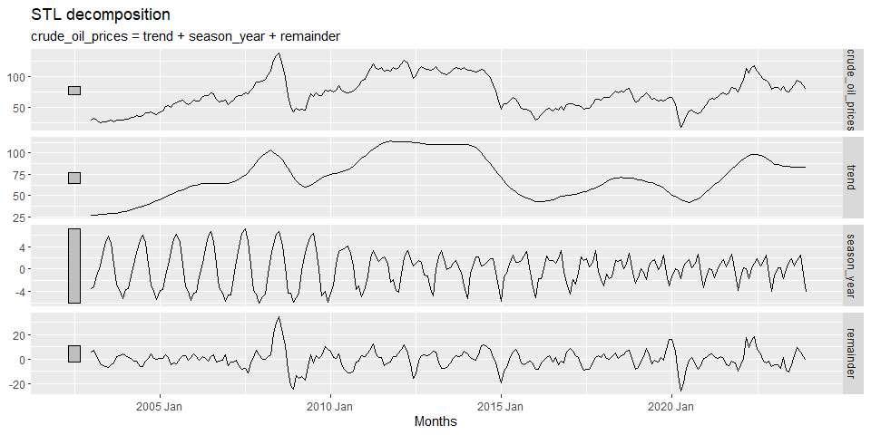
Session 8: Time Series Analysis: Decomposition of Time Series

Slide 14
Session 8: Time Series Analysis: ACF and PACF
Autocorrelation Function (ACF) and Partial Autocorrelation Function (PACF)
ACF and PACF are essential tools in time series analysis for identifying dependencies and selecting appropriate lags for models like AR, MA, and ARIMA.

Slide 15
Session 8: Time Series Analysis: ACF and PACF
1. Autocorrelation Function (ACF)
Autocorrelation measures how a time series is correlated with its past values (lags).
ACF Plot Interpretation:
Significant spikes at certain lags indicate strong correlation with past values.
If ACF decays slowly, the time series likely has a trend (non-stationary).
If ACF has seasonal spikes, the data exhibits seasonality.
If ACF cuts off after a few lags, the series might follow an MA(q) process.
Example:
ACF decaying gradually → AR process
ACF cutting off at lag q → MA(q) process

Slide 16
Session 8: Time Series Analysis: ACF and PACF
2. Partial Autocorrelation Function (PACF)
PACF measures the direct relationship between a time series and its past values by removing the effects of intermediate lags.
PACF Plot Interpretation:
Sharp cutoff at lag p suggests an AR(p) process.
If both ACF and PACF gradually decay, the series may be ARMA/ARIMA.
PACF can help determine the order of AR terms in ARIMA models.
Example:
PACF cuts off at lag p → AR(p) process
PACF has a gradual decay → ARMA process

Slide 17
Session 8: Time Series Analysis: ACF and PACF
How to Use ACF and PACF for Model Selection?
Model | ACF Behavior | PACF Behavior
AR(p) | Decays gradually | Cuts off at lag p
MA(q) | Cuts off at lag q | Decays gradually
ARMA(p, q) | Decays gradually | Decays gradually

Slide 18
Session 8: Time Series Analysis: ACF and PACF
What Does "Cutting Off at Lag p or q" Mean?
When we say "cutting off at lag p or q", we are referring to when the ACF or PACF plot suddenly drops to near zero after a certain lag and stays close to zero for all further lags.
1. ACF Cutting Off at Lag q (Moving Average Process – MA(q))
The ACF has significant spikes up to lag q but then drops close to zero after that.
This suggests that the time series follows an MA(q) process, meaning the current value is influenced by noise from the past q lags, but not beyond.
PACF, on the other hand, will decay gradually.
✅ Example: If ACF has spikes at lags 1, 2, 3, but is near zero after lag 3, we say ACF cuts off at lag 3, suggesting an MA(3) process.

Slide 19
Session 8: Time Series Analysis: ACF and PACF
2. PACF Cutting Off at Lag p (Autoregressive Process – AR(p))
The PACF has significant spikes up to lag p but then drops close to zero after that.
This suggests an AR(p) process, meaning the current value is influenced directly by its own past values up to lag p but not beyond.
ACF, in this case, will decay gradually.
✅ Example: If PACF has spikes at lags 1 and 2 but is near zero after lag 2, we say PACF cuts off at lag 2, suggesting an AR(2) process.

Slide 20
Session 8: Time Series Analysis: ACF and PACF
Example Interpretation
If ACF cuts off at lag 3 and PACF decays gradually, use an MA(3) model.
If PACF cuts off at lag 2 and ACF decays gradually, use an AR(2) model.
If both decay gradually, use an ARMA model.

Slide 21
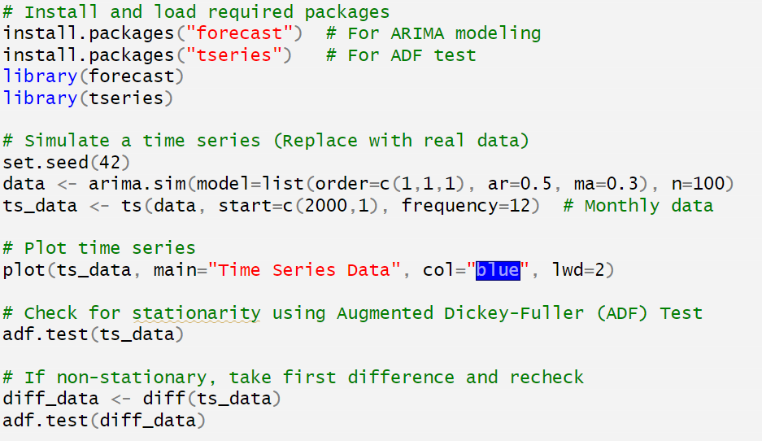
Session 8: Time Series Analysis: Time Series Data Preparatiom

Slide 22
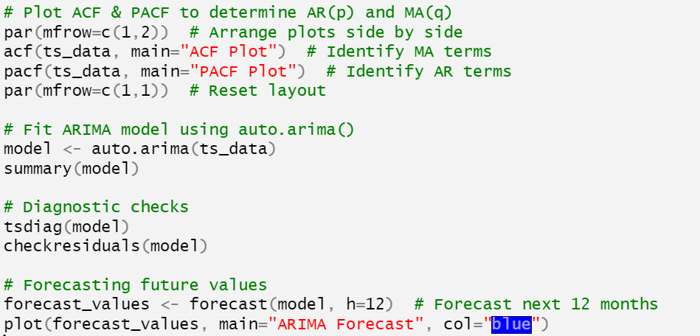
Session 8: Time Series Analysis: Model Estimation and Forecasting

Slide 23
Session 8: Time Series Analysis: Model Estimation and Forecasting
🔹 What This Code Does
✅ Loads necessary packages ✅ Simulates a time series ✅ Checks stationarity (ADF test) & differences data if needed ✅ Plots ACF & PACF to determine AR & MA terms ✅ Fits ARIMA using auto.arima() ✅ Checks residuals & diagnostics ✅ Forecasts the next 12 periods

Slide 24
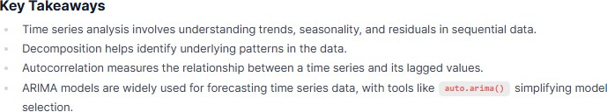
Session 8: Time Series Analysis

Slide 25

https://cdam.chuka.ac.ke
Thank you

